Slide 1
Chapter 2. Operating System Overview
CSci 474: Operating Systems Instructor: Dr. Jun Kong

Slide 2
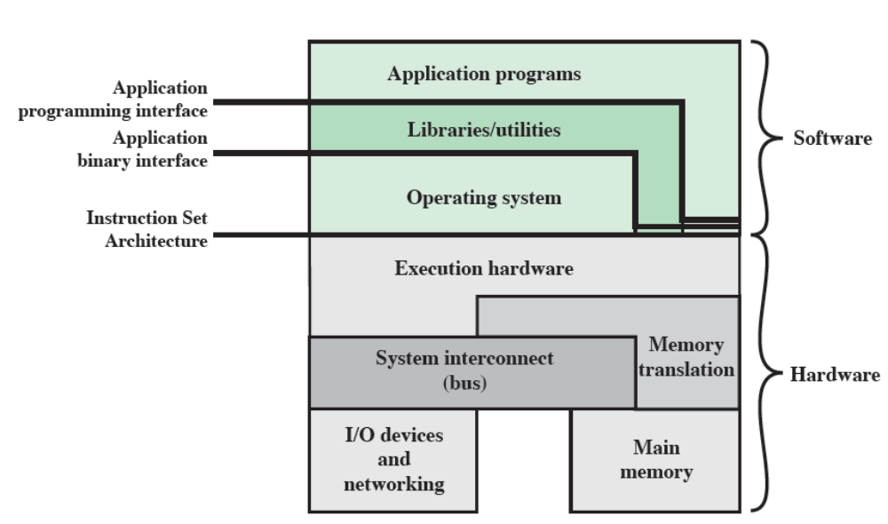
Operating System

Slide 3
Operating System
An interface between applications and hardware
A program that controls the execution of application programs

Slide 4
OS objectives
Convenience: provide a user/computer interface
Efficiency: act as a resource manager for the system
Ability to evolve: adaptable to new features, updates and changes

Slide 5
Convenience
The OS provides a user/computer interface to make it more convenient for users to use the system.
Application programmers and end users need a way to interact with the system hardware but usually don’t need to know details of the computer’s hardware.
The OS acts to insulate the user or programmer from hardware details
The OS provides services like file management and control of I/O devices that an end user or an application programmer needs.

Slide 6
Efficiency
A computer can be viewed as a set of resources.
If applications had ownership of system resources then sharing resources would be difficult.
It is better to let the OS own the resources, so the OS decides which programs get which resources.

Slide 7
Ability to evolve
OS evolves for many reasons:
  Hardware upgrades plus new kinds of hardware.
  New services.
  Fixes.
It is helpful if the OS is modular in design, which will make the changes listed above easier to implement.

Slide 8
Evolution of operating systems
Serial processing
Single batch systems
Multiprogrammed batch systems
Time-sharing systems

Slide 9
Serial Processing
Scheduling - consisted of sign-up sheet to reserve time to use the system. This resulted in wasted time because users might schedule too much or too little time.
Setup time – without an OS to manage resources, considerable time was spent in setting up a program to run with all of the right resources (mount tapes, etc.)

Slide 10
Single batch systems
A “monitor” program accepts a batch of jobs from the operator and runs each one in turn.
The user no longer has direct access to the machine, but instead submits the job to the computer operator to run.
The monitor (or most of it) remains in memory, called the “resident monitor”.
The monitor increases efficiency by scheduling each job in turn automatically, and by reducing setup time through a JCL (job control language), which specifies setup steps for the monitor.

Slide 11
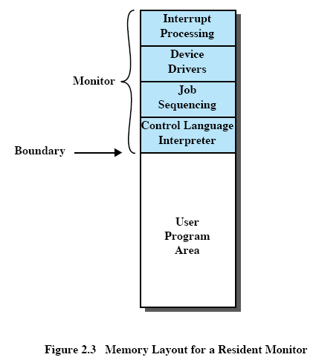
Menti: 75104150

Slide 12
Hardware features
Memory protection: don’t overwrite the monitor!
Timer: prevent a job from monopolizing the system
  If the timer expires, the user program is stopped and control returns to the monitor
Privileged Instructions: only the monitor can do certain things.
Interrupts: provide better way to handle transfer of control from the monitor to user programs.

Slide 13
User mode VS Kernel mode
Memory protection and privileged instruction lead to the concept of modes of operation
  User program executes in “user mode”: certain instructions may not be executed
  Monitor executes in “kernel mode”: no limitations

Slide 14

Uniprogramming
Processor must wait for I/O instruction to complete before proceeding --- This is not efficient use of the processor

Slide 15
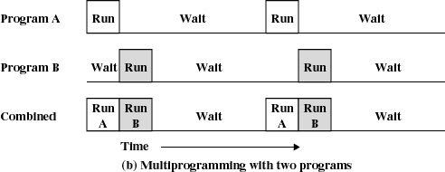
Multiprogramming
When one job needs to wait for I/O, the processor can switch to the other job.

Slide 16
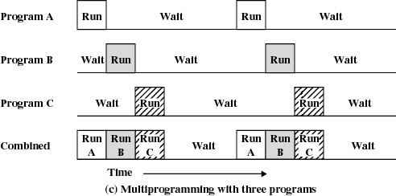
Multiprogramming
Adding more programs further increases the utilization

Slide 17
Sample Jobs
JOB1 JOB2 JOB3
Type of job Heavy compute Heavy I/O Heavy I/O
Duration 5 min. 15 min. 10 min.
Memory required 50M 100 M 80 M
Need disk? No No Yes
Need terminal No Yes No
Need printer? No No Yes
In multiprogramming, there is little resource contention between the jobs, so all three can run in nearly minimum time while coexisting with the others in the computer.

Slide 18
Results
Uniprogramming Multiprogramming
Elapsed time 30 min. 15 min.
Throughput rate 6 jobs/hr 12 jobs/hr
Mean resp. time 18 min. 10 min.
Notes:
The response time of each individual job is the waiting time plus the service time.
In uniprogramming: the waiting time of job 1 is 0; the waiting time of job 2 is ﻿﻿﻿﻿﻿﻿﻿﻿﻿﻿﻿﻿﻿﻿﻿﻿﻿5 (waiting for job 1) ; and the waiting time of job 3 is 5+15 (waiting for jobs 1 and 2)
In mutiprogramming: the waiting time of each job is 0 since they all start at the same time on different hardware.
Elapsed time in uniprogramming = 5+15+10=30 mins
Throughput rate in uniprogramming = 3/0.5 hour = 6 jobs/hour
Mean response time in uniprogramming = (5+(5+15)+(5+15+10))/3 = 18 mins
Elapsed time in multiprogramming = 15 (the longest service job) mins
Throughput rate in multiprogramming = 3/0.25 hour = 12 jobs/hour
Throughput rate in multiprogramming = (5+15+10)/3 = 10

Slide 19
Multiprogramming
Hardware features of I/O interrupts or DMA make multiprogramming effective.
Memory management is also more important for multiprogramming since several different jobs may be in memory.
Scheduling is also important to determine which of the jobs to run next.

Slide 20
Time-Sharing Systems
Batch systems run programs in the “background” and generally don’t have direct user interaction.
For some jobs, an interactive mode of processing required
Use multiprogramming to handle multiple interactive jobs
Processor’s time is split among the set of users
Multiple users simultaneously access the system terminals

Slide 21
Major OS Achievements
Processes
Memory management
Information protection and security
Scheduling and resource management

Slide 22
Processes
A process can be defined in many ways:
  A program in execution
  An instance of a program running on a computer
  The entity that can be assigned to and executed on a processor
  A unit of activity characterized by a single sequential thread of execution, a current state, and an associated set of system resources.

Slide 23
Processes
Demands of multiprogramming and time-sharing systems required a systematic way to monitor and control the various programs executing on the processor.
A process has three parts:
  An executable program
  The data the program is using
  The execution context

Slide 24
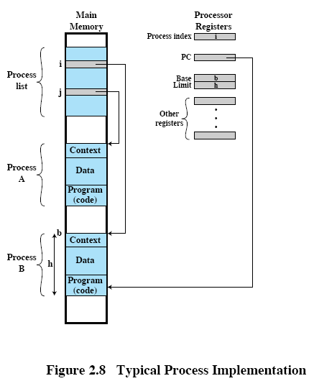
Process implementation
A process list may be used to keep track of processes.
The process list contains an entry for each process.
Each entry contains a pointer to the process in memory and perhaps process context information as well.

Slide 25
Memory management
Process isolation: prevent independent processes from interfering with each other’s memory
Automatic allocation and management
  Programs should be dynamically allocated across the memory hierarchy
  Allocation should be transparent to the programmer
Support of modular programming: define program modules and create, destroy and alter the size of modules dynamically
Protection and access control
Long-term storage

Slide 26
Virtual Memory
Allow programmers to address memory from a logical view of memory.
This gives the program a view of memory that may be much larger than physical memory.
Multiple programs may reside in main memory at the same time, yet appear to have all of memory to themselves.
A paging system swaps pieces of programs, called pages, that are the same size. This makes it easy to replace one piece with another.

Slide 27
Paging
Allow processes to be comprised of a number of FIXED-SIZE blocks, called “pages”.
A virtual address consists of a page number and an offset within the page.
The paging system maps the logical page to the physical page
Each page may be located any where in the main memory and pages are swapped from disk to main memory as the program runs

Slide 28
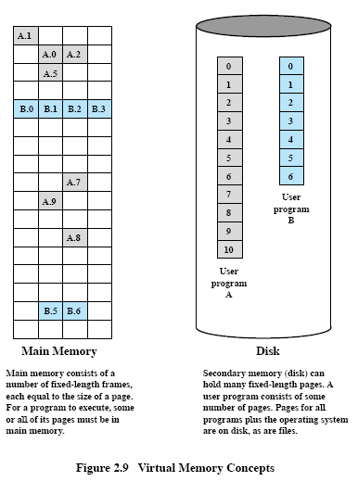

Slide 29
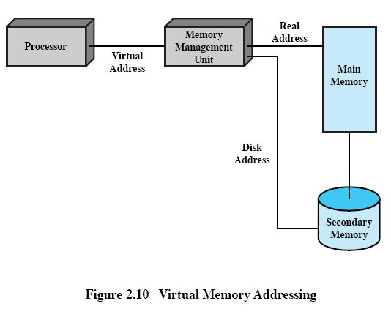

Slide 30
Information protection and security
Availability: protect the system against interruption
Confidentiality: data can only be accessed by those authorized to do so
Data integrity: protection of data from unauthorized modification
Authenticity: the verification of the identity and the validity of messages or data

Slide 31
Scheduling and resource management
Differential responsiveness: make scheduling decisions based on needs of a particular process
Fairness: processes should get equal treatment (if same class and priority)
Efficiency: maximize throughput and minimize response time

Slide 32
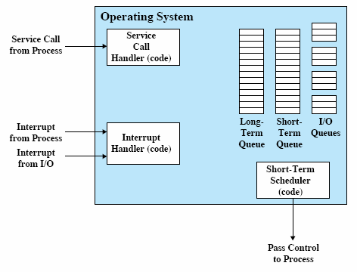
A “short-term” queue contains processes currently in main memory. Any of these processes could be run next.
A “long-term” queue contains processes waiting to run (by being moved to the short-term queue).
There may also be a series of I/O queues for processes awaiting an I/O device.

Slide 33
Modern OS Characteristics
Microkernel architecture
Multithreading
Symmetric multiprocessing
Distributed operating systems
Object-oriented design

Slide 34
Microkernel architecture
Assign only a few essential functions to the kernel (such as address space, interprocess communication, scheduling)
Other services are provided by processes that run like any other process
This approach simplifies the implementation, provides flexibility and lends itself well to distributed computing by treating remote and local processes the same way

Slide 35
Microkernels
Small operating system core
Contains only essential core operating systems functions
Many services traditionally included in the operating system are now external subsystems
  Device drivers
  File systems
  Virtual memory manager
  Windowing system
  Security services

Slide 36
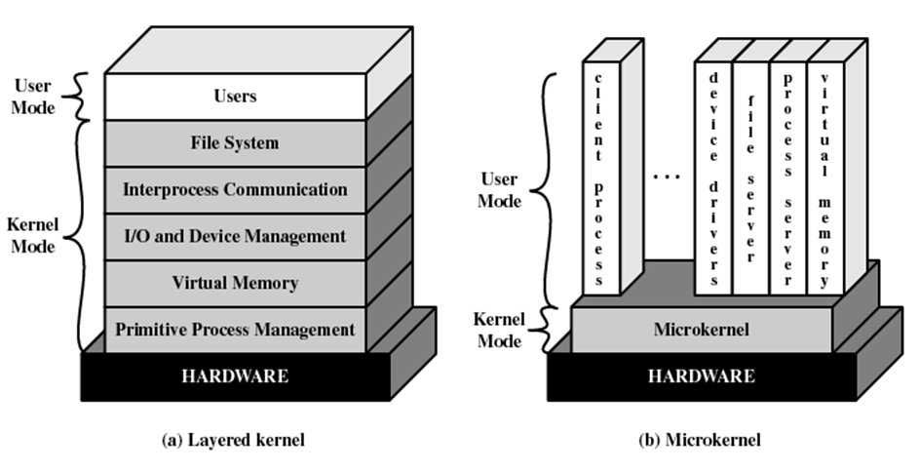

Slide 37
Benefits of a Microkernel Organization
Uniform interface on request made by a process
  Don’t distinguish between kernel-level and user-level services
  All services are provided by means of message passing
Extensibility
  Allows the addition of new services
Flexibility
  New features added
  Existing features can be subtracted

Slide 38
Benefits of a Microkernel Organization
Portability
  Changes needed to port the system to a new processor are in the microkernel - not in the other services
Reliability
  Small microkernel can be rigorously tested

Slide 39
Benefits of Microkernel Organization
Distributed system support
  Message are sent without knowing what the target machine is
Object-oriented operating system
  Components are objects with clearly defined interfaces that can be interconnected to form software

Slide 40
Microkernel Design
The dividing line between what is in and what is outside the microkernel varies from one design to the next
  Low-level memory management: Mapping each virtual page to a physical page frame
  Interprocess communication (IPC)
  I/O and interrupt management

Slide 41
Multithreading
Process is divided into threads that can run concurrently
  Process: one or more threads plus associated system resources
  Thread: a dispatchable unit of work
This is more efficient than creating separate processes

Slide 42
Symmetric multiprocessing (SMP)
Modern machines may have more than one processor.
One way to manage multiple processors is known as SMP.
SMP systems have these characteristics:
  there are multiple processors
  these processors share same main memory and I/O facilities
  All processors can perform the same functions
  (symmetric)
An SMP OS can schedule threads on any available processor in the system.

Slide 43
SMP Advantages Versus Uniprocessor
Performance: parallel processing
Availability: a processor failure only slows the system versus halting it.
Incremental growth: add additional processors.
Scaling: vendors can offer products based on number of processors available.

Slide 44
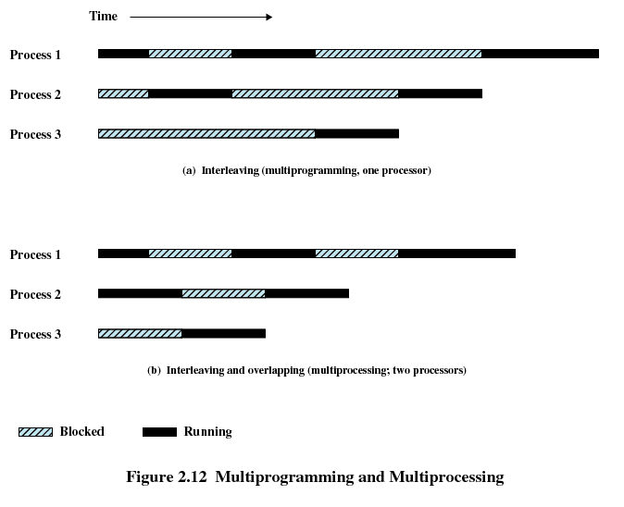

Slide 45
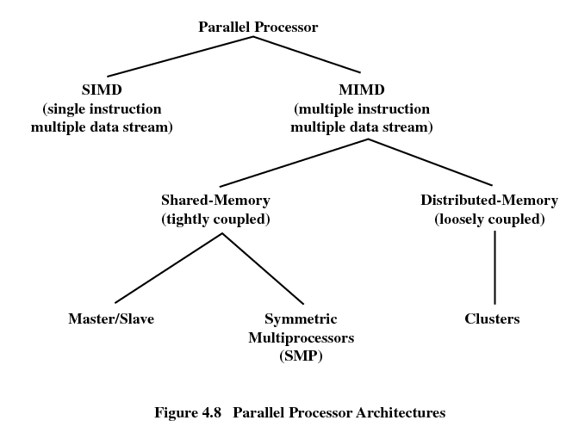

Slide 46
Multiprocessor Operating System Design Considerations
Simultaneous concurrent processes or threads
  With multiple processors executing the same or different parts of the kernel, kernel tables and management structures must be managed properly to avoid deadlock or invalid operations
Scheduling
  Scheduling may be performed by any processor, so conflicts must be avoided
Synchronization
  Synchronization is a facility that enforces mutual exclusion and event ordering
Memory management
  Enforce consistency when several processors share a page or segment
Reliability and fault tolerance
  Provide graceful degradation in the face of processor failure.

Slide 47
Distributed OS
Multiple machines may be managed together with a distributed operating system.
This provides the illusion of a single main memory and single secondary memory space for a cluster of separate computers.
Increasingly common, but still lags behind uniprocessor and SMP systems.

Slide 48
Object-Oriented Design
Object-oriented design techniques can be applied to the operating system.
Enables adding modular extensions to a small kernel.
Enables programmers to customize an operating system without disrupting system integrity.
Gives the OS many of the benefits of object-orientation.

Slide 49
Windows organization
Windows does not have a pure microkernel architecture
Highly modular structure for flexibility
  Each system function is managed by just one component of the operating system
  The rest of the operating system and all applications access that function through the responsible component using a standard interface
  Any module can be removed, upgraded, or replaced without rewriting the entire system

Slide 50
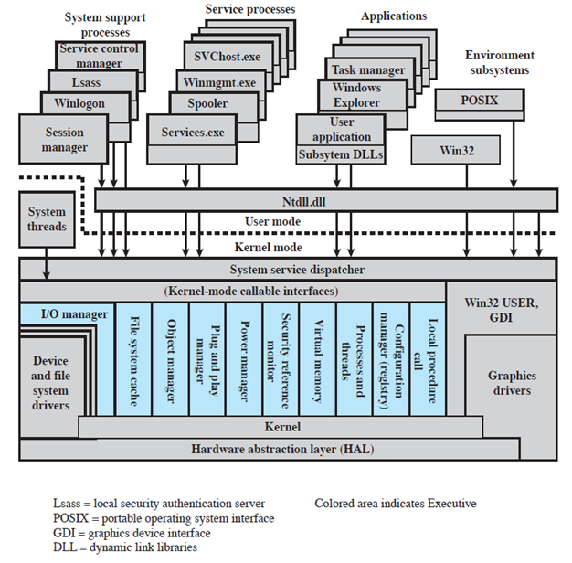

Slide 51
Kernel-Mode Components
Executive: contain basic operating system services (such as memory management, process and thread management, security, I/O, interprocess communication)
Kernel: consists of the most used components and most fundamental components (such as thread scheduling, process switching)

Slide 52
Kernel-Mode Components
Hardware abstraction layer (HAL): isolates the operating system from platform-specific hardware differences
Device drivers: translate user I/O function calls into specific hardware device I/O requests
Windowing and graphics systems: implement the graphical user interface (GUI)

Slide 53
User-Mode Processes
Special system support processes
  Ex: logon process and the session manager
Service processes: other windows services (such as event logger)
Environment subsystems: run applications written for many different types of operating systems (such as 32-bit Windows applications, 16-bit character-based OS/2 applications and applications that are strictly written to either the POSIX.1 standard or the related ISO/IEC standards. )
User applications

Slide 54
UNIX architecture
Hardware is surrounded by the operating system software
Operating system is called the system kernel
Comes with a number of user services and interfaces
  Shell
  Components of the C compiler

Slide 55
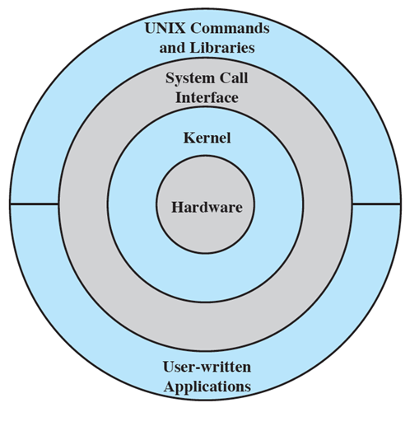
UNIX Architecture

Slide 56
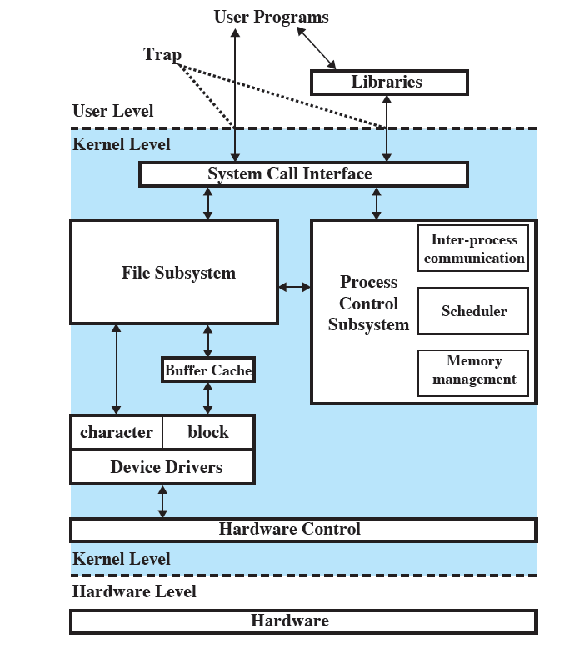
UNIX Kernel

Slide 57
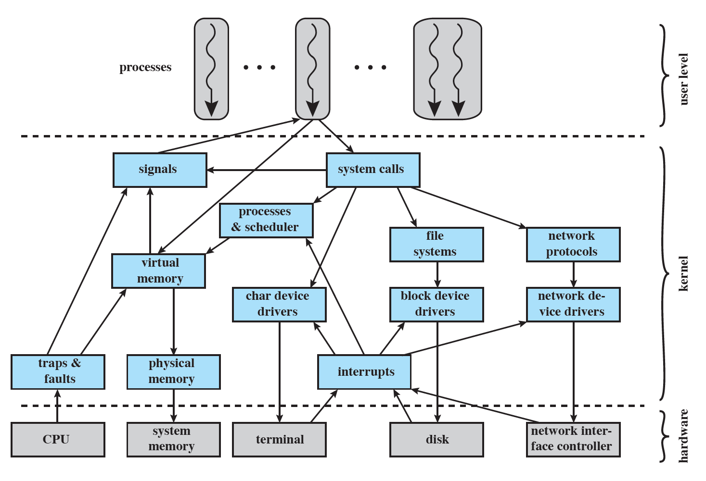
Linux Kernel Components

Slide 58
Linux Kernel Components
Signals: The kernel uses signals to call into a process
System calls: Request a specific kernel service
Processes and scheduler: creates, manages and schedules processes
Virtual memory: allocate and manage virtual memory

Slide 59
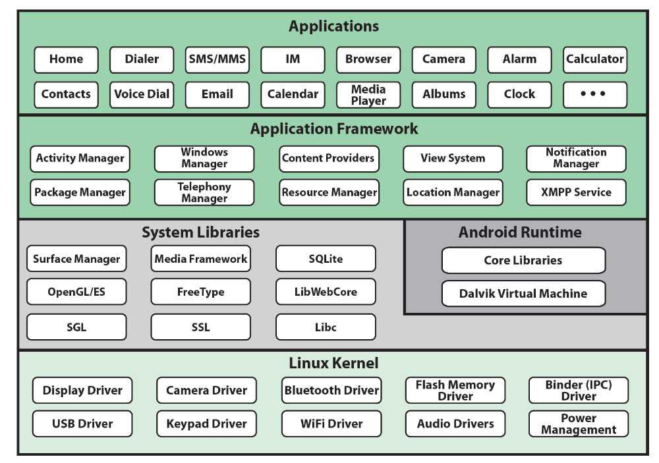
Android Architecture

Slide 60
Android Architecture
Application framework: provide high-level building blocks to create new apps
System libraries: a collection of system functions, written in C/C++
Linux Kernel: Core system services such as memory management and process management

